Slide 1
A NOVEL ROTATING DERMATOME IN BURNS: IMPROVED EFFICIENCY AND OUTCOMES
A Raghuram BA¹, J Zeitouni BBA¹, J Allen BS¹, G Aickareth BS¹, M Dang MS¹, D Bettarelli BS¹, D Kurtz BA BS MBA³, J Griswold MD², A Pang MD²
¹Texas Tech University Health Sciences Center School of Medicine
²Texas Tech University Health Sciences Center, Department of Surgery
³Kurtz Consulting Inc.
Lubbock, Texas

Slide 2
Disclosures
John Griswold, MD
Medline: consultant on wound dressing applicable to burns
Exsurco Medical: advisory board of donor harvesting equipment
Alan Pang, MD
Exsurco Medical: consultant on donor harvesting equipment
Debra Kurtz BS BA MBA
Exsurco Medical: consultant
This research did not receive any specific grant from funding agencies in the public, commercial, or not-for-profit sectors.
Notes:
I have the following disclosures to disclose

Slide 3
Introduction
Burn injuries rank fourth among common trauma injuries globally.
Approximately 500,000 burn injuries are reported annually; around 40,000 require hospitalization in 128 burn facilities in the U.S.
Priority in burn trauma: ABCs of trauma – Airway, Breathing, and Circulation
Major burns may necessitate endotracheal tubes
Concerns: smoke inhalation, carbon monoxide poisoning, compartment syndrome
Post-evaluation tasks: wound closure, metabolic response management, and treating infections/organ dysfunction
We use a novel rotary dermatome for skin excision and donor harvest – an alternative to traditional reciprocating dermatomes
Notes:
"Burn injuries are a significant concern, ranking fourth among trauma injuries worldwide. Every year, we see around half a million cases, with 40,000 requiring specialized care in U.S. burn facilities.
In addressing these injuries, the ABCs of trauma – Airway, Breathing, and Circulation – are crucial. Major burns often necessitate endotracheal tubes, especially with complications like smoke inhalation.
After stabilization, wound management becomes paramount. Traditionally, we've used reciprocating dermatomes. However, the introduction of the Amalgatome SD offers a smoother and more efficient approach.

Slide 4
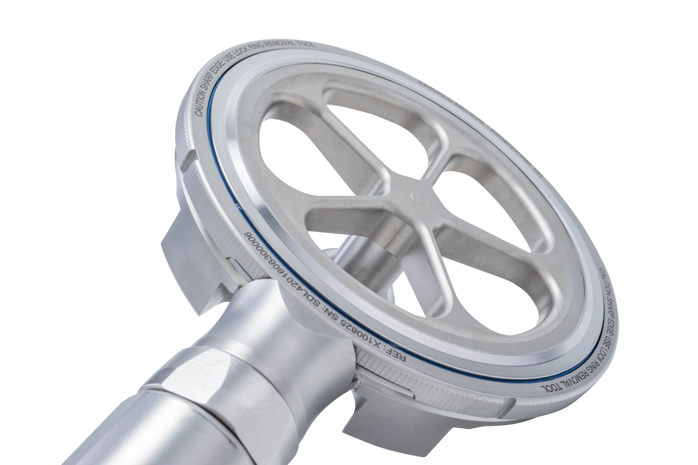
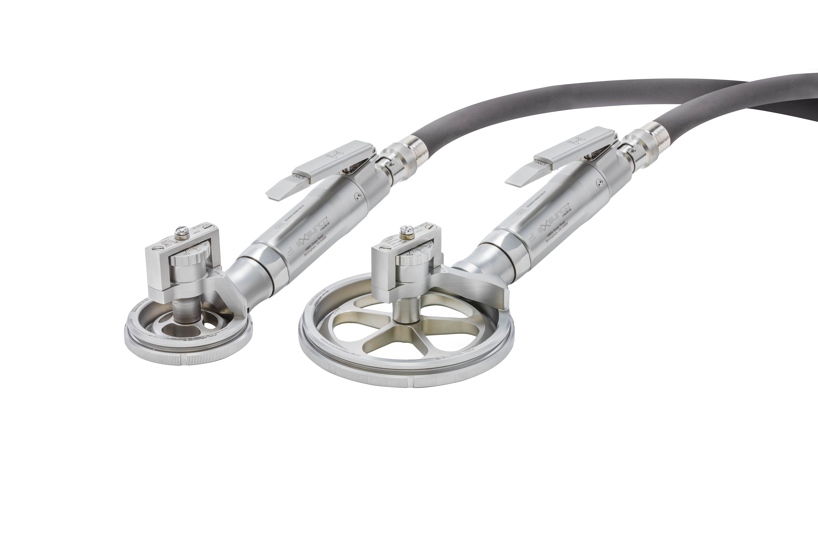
Methods
Study conducted at Timothy J. Harnar Regional Burn Center, TTUHSC, Lubbock, Texas – a rural regional burn center covering west Texas and New Mexico
Retrospective analysis of 257 burn cases from 2017-2022; transition from standard reciprocating dermatome to rotating dermatome in August 2021
Data breakdown: 88 cases using dermatome, 169 with the novel rotary dermatome ; analyzed using SPSS Software Platform
Source: Exsurco Medical
Notes:
"We centered our study at the Timothy J. Harnar Regional Burn Center in Lubbock, Texas, uniquely serving vast rural areas of western Texas and New Mexico.
We analyzed 257 burn cases from 2017 to 2022, highlighting the shift in August 2021 from the traditional reciprocating dermatome to the Amalgatome SD. The ASD, with its round blade, offers a more tailored approach to debridement and grafting.
For clarity, we divided our data: 88 cases using the dermatome and 169 with the ASD, all analyzed using the SPSS Software Platform. This division offers a clear view of the Amalgatome SD's introduction and impact."

Slide 5
Table 1: Patient Data by Device
Device Used |  | Pt. Age | TBSA | LOS | OR Time #1 | Graft Size | Graft Take
Dermatome | Mean | 42.38 | 12.48 | 20.92 | 117.01 | 1046.76 | 91.54
 | N | 88 | 86 | 88 | 87 | 88 | 87
 | Std. Deviation | 19.279 | 13.768 | 21.913 | 66.920 | 1092.040 | 17.147
 | Median | 42.50 | 8.00 | 13.00 | 95.00 | 626.50 | 97.00
 | % of Total Sum | 31.6% | 27.2% | 28.7% | 37.2% | 28.1% | 37.9%
 | Minimum | 6 | 0 | 0 | 23 | 10 | 0
 | Maximum | 86 | 61 | 136 | 283 | 6207 | 100
Novel rotating dermatome | Mean | 47.83 | 18.85 | 27.07 | 101.72 | 1392.47 | 94.51
 | N | 169 | 152 | 169 | 169 | 169 | 138
 | Std. Deviation | 17.198 | 17.750 | 25.533 | 50.310 | 1717.994 | 10.723
 | Median | 47.00 | 13.00 | 19.00 | 91.00 | 756.00 | 98.00
 | % of Total Sum | 68.4% | 72.8% | 71.3% | 62.8% | 71.9% | 62.1%
 | Minimum | 12 | 0 | 1 | 15 | 12 | 25
 | Maximum | 82 | 79 | 156 | 295 | 10682 | 100
Total | Mean | 45.96 | 16.55 | 24.97 | 106.91 | 1274.09 | 93.36
 | N | 257 | 238 | 257 | 256 | 257 | 225
 | Std. Deviation | 18.087 | 16.678 | 24.486 | 56.838 | 1539.227 | 13.613
 | Median | 45.00 | 10.50 | 15.55 | 93.50 | 716.00 | 98.00
 | % of Total Sum | 100.0% | 100.0% | 100.0% | 100.0% | 100.0% | 100.0%
 | Minimum | 6 | 0 | 0 | 15 | 10 | 0
 | Maximum | 86 | 79 | 156 | 295 | 10682 | 100
Notes:
Table 1 shows the patient case data summarized by the device used. TBSA was determined by utilization of the Lund and Browder chart. LOS = Length of stay measured in days. Time in minutes for the patient’s first operation = OR Time #1. Graft size was measured in square centimeters. Graft take was visually estimated by the care team.

Slide 6
Table 2: Analysis of Variance (ANOVA)
 |  |  | Sum of Squares | df | Mean Square | F | P-value
Age * Device | Between Groups | Combined | 1720.962 | 1 | 1720.962 | 5.350 | .022
 | Within Groups |  | 82026.649 | 255 | 321.673
 | Total |  | 83747.611 | 256
TBSA * Device | Between Groups | Combined | 2233.543 | 1 | 2233.543 | 8.277 | .004
 | Within Groups |  | 63688.063 | 236 | 269.865
 | Total |  | 65921.606 | 237
LOS * Device | Between Groups | Combined | 2190.558 | 1 | 2190.558 | 3.692 | .056
 | Within Groups |  | 151301.967 | 255 | 593.341
 | Total |  | 153492.524 | 256
OR Time #1 * Device | Between Groups | Combined | 13436.754 | 1 | 13436.754 | 4.212 | .041
 | Within Groups |  | 810355.355 | 254 | 3190.375
 | Total |  | 823792.109 | 255
Graft Size * Device | Between Groups | Combined | 6916151.392 | 1 | 6916151.392 | 2.941 | .088
 | Within Groups |  | 599604410.165 | 255 | 2351389.844
 | Total |  | 606520561.556 | 256
Graft Take * Device | Between Groups | Combined | 472.035 | 1 | 472.035 | 2.565 | .111
 | Within Groups |  | 41040.080 | 223 | 184.036
 | Total |  | 41512.116 | 224
Notes:
An analysis of variance of the data revealed that there was a significant difference between the device groups where the ASD patients were older in age (F(1, 255) = [5.350], p = 0.022), had greater TBSA (F(1, 236) = [8.277], p = 0.004), had longer length of patient stay (F(1, 255) = [3.692], p = 0.056) , and shorter the first operative time (F(1, 254) = [4.212], p = 0.041). There were no statistically significant differences between the two devices in terms of graft size or the percentage of graft take in the patients.
In order to analyze device differences between the size of burns, the data was segmented into small-sized burns (TBSA up to 15%), medium-sized burns (TBSA from 16%-25%) and large-sized burns (TBSA above 25%).

Slide 7
Table 3: ANOVA for Small-Sized Burns (TBSA ≤ 15%)
 |  |  | Sum of Squares | df | Mean Square | F | P-value
Age * Device | Between Groups | Combined | 1525.698 | 1 | 1525.698 | 4.558 | .034
 | Within Groups |  | 54556.096 | 163 | 334.700
 | Total |  | 56081.794 | 164
TBSA * Device | Between Groups | Combined | .448 | 1 | .448 | .026 | .873
 | Within Groups |  | 2528.996 | 144 | 17.562
 | Total |  | 2529.445 | 145
LOS * Device | Between Groups | Combined | 1506.820 | 1 | 1506.820 | 5.009 | .027
 | Within Groups |  | 49038.314 | 163 | 300.849
 | Total |  | 50545.134 | 164
OR Time #1 * Device | Between Groups | Combined | 12558.259 | 1 | 12558.259 | 4.863 | .029
 | Within Groups |  | 420972.444 | 163 | 2582.653
 | Total |  | 433530.703 | 164
Graft Size * Device | Between Groups | Combined | 15964.082 | 1 | 15964.082 | .027 | .869
 | Within Groups |  | 94764291.867 | 163 | 581376.024
 | Total |  | 94780255.949 | 164
Graft Take * Device | Between Groups | Combined | 25.086 | 1 | 25.086 | .155 | .694
 | Within Groups |  | 24438.751 | 151 | 161.846
 | Total |  | 24463.837 | 152
Notes:
For the small-sized burns, an analysis of variance of the data as seen in Table 3 revealed once again that there was a significant difference between the device groups where the ASD patients were older in age (F(1, 163) = [4.558], p = 0.034), had longer length of patient stay (F(1, 163) = [5.009], p = 0.027) , and shorter first operative time (F(1, 163) = [4.863], p = 0.029). With this small-sized burn group, there were no statistically significant differences between the two devices in terms of TBSA, graft size or the percentage of graft take in the patients.

Slide 8
Table 4: ANOVA for Medium-Sized Burns (TBSA 16-25%)
 |  |  | Sum of Squares | df | Mean Square | F | P-value
Age * Device | Between Groups | Combined | 703.033 | 1 | 703.033 | 1.800 | .188
 | Within Groups |  | 14448.403 | 37 | 390.497
 | Total |  | 15151.436 | 38
TBSA * Device | Between Groups | Combined | 20.398 | 1 | 20.398 | 2.441 | .127
 | Within Groups |  | 309.179 | 37 | 8.356
 | Total |  | 329.577 | 38
LOS * Device | Between Groups | Combined | 648.857 | 1 | 648.857 | 3.148 | .084
 | Within Groups |  | 7625.499 | 37 | 206.095
 | Total |  | 8274.355 | 38
OR Time #1 * Device | Between Groups | Combined | 8281.775 | 1 | 8281.775 | 3.796 | .059
 | Within Groups |  | 80718.584 | 37 | 2181.583
 | Total |  | 89000.359 | 38
Graft Size * Device | Between Groups | Combined | 42280.328 | 1 | 42280.328 | .026 | .873
 | Within Groups |  | 60536516.567 | 37 | 1636122.069
 | Total |  | 60578796.894 | 38
Graft Take * Device | Between Groups | Combined | 2448.545 | 1 | 2448.545 | 8.261 | .007
 | Within Groups |  | 9187.955 | 31 | 296.386
 | Total |  | 11636.500 | 32
Notes:
For the medium-sized burns, an analysis of variance of the data as seen in Table 4 revealed once again that there was a significant difference between the device groups were the ASD patients had shorter the first operative time (F(1, 37) = [3.796], p = 0.059). Additionally there was a significant difference where the ASD patients had greater graft take, (F(1, 31) = 8.261], p = 0.007. There were no statistically significant differences between the two devices in terms of Age, TBSA, LOS, or graft size.

Slide 9
Table 5: ANOVA for Large-Sized Burns (TBSA ≥ 25%)
 |  |  | Sum of Squares | df | Mean Square | F | P-value
Age * Device | Between Groups | Combined | 481.988 | 1 | 481.988 | 2.933 | .105
 | Within Groups |  | 2794.118 | 17 | 164.360
 | Total |  | 3276.105 | 18
TBSA * Device | Between Groups | Combined | 2.415 | 1 | 2.415 | .476 | .500
 | Within Groups |  | 86.243 | 17 | 5.073
 | Total |  | 88.658 | 18
LOS * Device | Between Groups | Combined | 102.532 | 1 | 102.532 | .399 | .536
 | Within Groups |  | 4371.304 | 17 | 257.136
 | Total |  | 4473.836 | 18
OR Time #1 * Device | Between Groups | Combined | 8687.556 | 1 | 8687.556 | 4.851 | .042
 | Within Groups |  | 30442.971 | 17 | 1790.763 | 1790.763
 | Total |  | 39130.526 | 18
Graft Size * Device | Between Groups | Combined | 267844.762 | 1 | 267844.762 | .093 | .764
 | Within Groups |  | 48952891.765 | 17 | 2879581.869
 | Total |  | 49220736.526 | 18
Graft Take * Device | Between Groups | Combined | 121.918 | 1 | 121.918 | 12.347 | .003
 | Within Groups |  | 157.984 | 16 | 9.874
 | Total |  | 279.903 | 17
Notes:
The results for patients with large-sized burns over 25% TBSA where similar to the medium-sized burn group. The analysis of variance of the data as seen in Table 5 revealed that there were significant differences between the device groups where the ASD patients had shorter first operative time (F(1, 17) = [4.851], p = 0.042) and greater graft take, (F(1, 16) = 12.347], p = 0.003. There were no statistically significant differences between the two devices in terms of Age, TBSA, LOS, or graft size.

Slide 10
Discussion
Compared to dermatome, rotating dermatome-treated patients were generally older but had quicker first surgeries
The rotating dermatome led to shorter operative times across all TBSAs
Greater graft uptake was observed with the rotating dermatome, especially in medium and large burn areas
Despite improved surgical outcomes, the rotating dermatome patients had longer stays for small burns, potentially due to age differences
This study emphasizes shorter operating times and better outcomes with the rotating dermatome for medium and large burns
Notes:
"In our comparison between the traditional dermatome mechanism and the ASD, a few key trends emerged. Firstly, patients treated with ASD were, on average, older but had notably shorter first surgeries. This device demonstrated its efficiency, shortening operative times across all burn surface areas. More compelling was the increased graft uptake with the ASD, especially for medium to large burns. However, a notable observation was that patients with small burns under ASD treatment had longer hospital stays - a factor that might be influenced by the average age of the patients. Nevertheless, the data leans favorably towards the ASD in terms of operating efficiency and patient outcomes for more severe burns."

Slide 11
Limitations & Future Research
Study limitation: difficulty comparing OR times for patients with multiple surgeries
The rotating dermatome potentially reduces the number of surgeries for many patients
Dataset derived solely from a single West Texas burn center catering to a rural demographic
Limited representation: not necessarily indicative of broader U.S. population
Further research required across different regions/burn centers to validate and generalize findings
Notes:
"While our study sheds light on the potential benefits of the ASD, it’s crucial to recognize its limitations. Comparing OR times was challenging, especially for patients who underwent multiple surgeries. However, the silver lining is that ASD might reduce the number of surgeries required for many patients. A significant limitation is the exclusive data from a single burn center in West Texas, which primarily serves a rural community. This means our findings might not fully represent the diverse U.S. population. To truly grasp the ASD's impact, it's vital that future research includes burn centers from different regions, giving us a more comprehensive picture."

Slide 12
Conclusion
Burn patients see tangible benefits: reduced operative time, decreased hypothermia (due to decreased OR time), and enhanced graft take
Analysis of 257 cases showed the rotating dermatome with reduced operative time significantly compared to the standard dermatome
For medium and large burns, the rotating dermatome resulted in significantly better graft take
Overall, using the rotating dermatome led to improved outcomes in our study cohort of burn trauma patients
Notes:
Our findings underscore the benefits for burn patients: decreased hypothermia and shorter operative times. Analyzing 257 cases, the Amalgatome SD notably reduced operative time compared to traditional methods, especially for medium and large burns.
In essence, our research affirms the Amalgatome SD not only enhances graft take but also significantly improves overall outcomes in our burn trauma cohort. The future looks promising with such innovations in burn care."

Slide 13
References
Burn incidence fact sheet. Chicago: American Burn Association. 2016
Greenhalgh DG. Management of Burns. N Engl J Med. Jun 13 2019;380(24):2349-2359. doi:10.1056/NEJMra1807442
Taylor SL, Sen S, Greenhalgh DG, Lawless M, Curri T, Palmieri TL. A competing risk analysis for hospital length of stay in patients with burns. JAMA Surg. May 2015;150(5):450-6. doi:10.1001/jamasurg.2014.3490
Romanowski KS, Palmieri TL, Sen S, Greenhalgh DG. More Than One Third of Intubations in Patients Transferred to Burn Centers are Unnecessary: Proposed Guidelines for Appropriate Intubation of the Burn Patient. J Burn Care Res. Sep-Oct 2016;37(5):e409-14. doi:10.1097/BCR.0000000000000288
Shirani KZ, Pruitt BA, Jr., Mason AD, Jr. The influence of inhalation injury and pneumonia on burn mortality. Ann Surg. Jan 1987;205(1):82-7. doi:10.1097/00000658-198701000-00015
Greenhalgh DG, Saffle JR, Holmes JHt, et al. American Burn Association consensus conference to define sepsis and infection in burns. J Burn Care Res. Nov-Dec 2007;28(6):776-90. doi:10.1097/BCR.0b013e3181599bc9
Cartotto R, Greenhalgh DG, Cancio C. Burn State of the Science: Fluid Resuscitation. J Burn Care Res. May/Jun 2017;38(3):e596-e604. doi:10.1097/BCR.0000000000000541
Cartotto R, Burmeister DM, Kubasiak JC. Burn Shock and Resuscitation: Review and State of the Science. J Burn Care Res. Feb 26 2022;doi:10.1093/jbcr/irac025
Williams FN, Jeschke MG, Chinkes DL, Suman OE, Branski LK, Herndon DN. Modulation of the hypermetabolic response to trauma: temperature, nutrition, and drugs. J Am Coll Surg. Apr 2009;208(4):489-502. doi:10.1016/j.jamcollsurg.2009.01.022
Eriksson E, Grossman P, Pittinger T, Ellis C, Gillenwater J, Short T. Consensus on the Benefits of the Exsurco Medical Amalgatome SD in the Treatment of Burns and Other Wounds. Eplasty. 2019;19:pb5.

Slide 14
Thank You

