Slide 1
Precision in Skin Grafting: A Cadaveric Study
Genesy Aickareth, BS, Elizabeth Brown, MD, Debra Kurtz, Michelle Tarbox, MD, John Griswold, MD, Alan Pang, MD

Slide 2
Disclosures:
Dr. Pang is a speaker/honoraria for Exsurco and Avita
Dr. Griswold is a speaker/honoraria for Exsurco and Avita
Debra Kurtz is a marketing consultant for Exsurco

Slide 3
Background:
Split-thickness skin grafts (STSG) is a surgical procedure used to repair extensive skin loss
Harvested skin includes epidermis and a portion of the dermis
STSGs are favored for their ability to cover large areas of damaged skin and promote wound healing
STSGs are often used for treatment of 2nd and 3rd-degree burns
The traditional dermatome (TD) and novel dermatome with a rotating circular blade (DRO) are devices that have been used for skin grafting since the 1950 and 2013, respectively

Slide 4
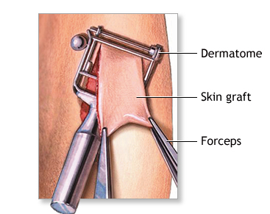
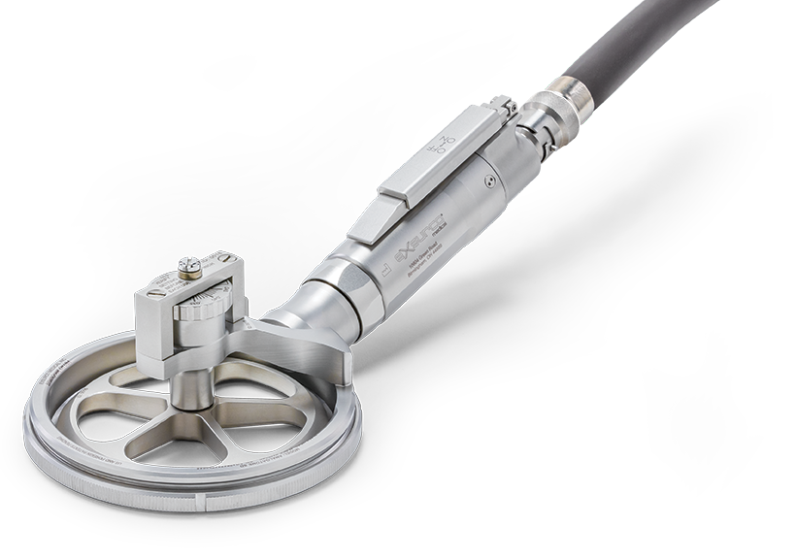
Background:
Few comparative studies have been conducted analyzing the TD versus the DRO devices
This study compared TD versus DRO for the uniform thickness within the skin graft, consistency with the depth gauge, the varying skill levels of harvesting grafts, and the impact of two different donor sites

Slide 5
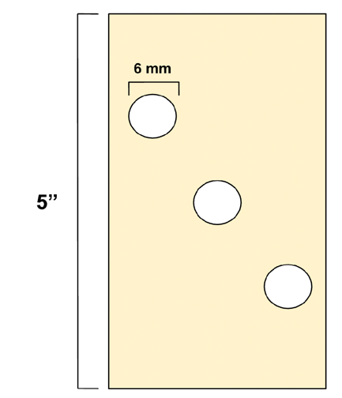
Methods:
Harvesting participants were recruited to represent 4 skill levels in skin grafting
Each subject harvested a 5-in length graft using each device on a deidentified cadaver
The subjects harvested at two different locations: the back and leg
Each harvested section was punched and analyzed by dermatopathology for depth and sufficient graft harvest

Slide 6
Data:
Average Skin Graft Depth by Device
 | TD | DRO
Average Depth (in) | .0119 | .0080
Both instruments set to .009 inches
A total of 118 grafts were analyzed
The TD was significantly thicker by 33% than the DRO (p-value of <=.046)
When compared to the depth gauge setting of 0.009 inches, the TD averaged 33% thicker and the DRO averaged 11% thinner
The 3 punches taken from the samples were more uniform with the DRO device than the TD

Slide 7
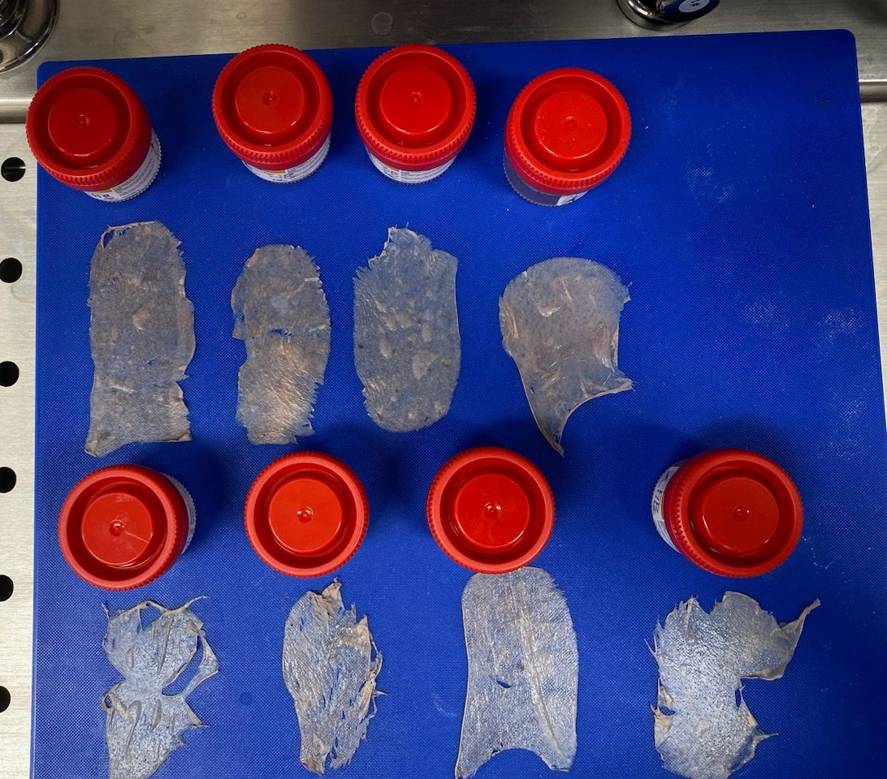
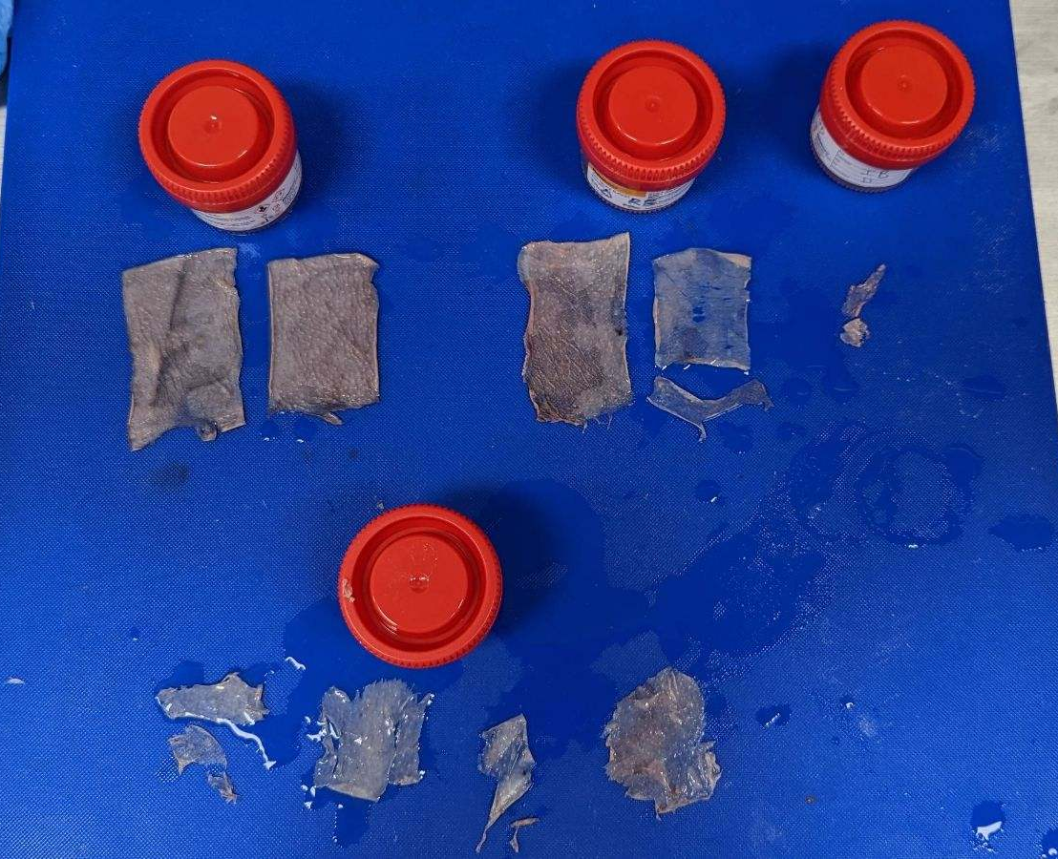
Data:
Macroscopic view of samples from the TD instrument
Macroscopic view of samples from the DRO instrument

Slide 8
Data:
Skin Graft Depth by Device and Skill Level
Skill Level | TD Depth Average (in) | DRO Depth Average (in)
Medical student | .0104 | .0082
Intern | .0095 | .0083
Resident | .0122 | .0081
Higher-Level | .0167 | .0071
There were no significant differences in graft depth between the levels of the harvesters.
Notes:
-note how consistent the amato

Slide 9
Conclusion:
Our study showed the sample depth taken with DRO was closer to the depth gauge level value than the TD and was more uniform throughout the graft
A thin, consistent graft thickness could lead to better graft take and improved healing of the donor site
Limits to the study include small sample size and the use of a cadaver instead of a live patient
The study can be expanded upon by increasing the population size in the future to solidify the results from this study
Notes:
-thicker is more liker to gouge
-ease of the person
-amalatome is heave

